Slide 1
What Are the Oncologic Risks of Morcellation of the Uterus?
Frédéric Amant, MD, PhD
UZ Leuven
Catholic University of Leuven
Leuven, Belgium

Slide 2
Take-Home Message
Morcellation of uterine leiomyomas poses risk of spreading undetected cancerous tissue in women with unsuspected cancer
Risk reduction strategies:
Abandon morcellation
Patient triage
Morcellation in laparoscopic bag?
Informed consent
3-4 higher chance recurrence
2.5 fold chance to die of disease

Slide 3
Agenda
Hot issue
Pathology and diagnosis of uterine smooth muscle cell tumors
Morcellation of leiomyomas
Morcellation of sarcomas
Risks of morcellation
Prevention of sarcoma morcellation
Treatment after sarcoma morcellation
Take-home message

Slide 4

Hot Topic (I)
Amy Reed, MD, an anesthesiologist at Beth Israel Hospital in Boston.
The Wall Street Journal: morcellation of LMS may have worsened her prognosis.
Campaign calling for a ban on morcellation.
LMS, leiomyosarcoma
Notes:
Amy Reed, MD, an anesthesiologist at Beth Israel Hospital in Boston, was diagnosed with fibroids in October 2013.
The Wall Street Journal: morcellation of LMS may have worsened her prognosis by spreading the cancer around her abdomen.
Since then, Dr. Reed's husband, cardiothoracic surgeon Hooman Noorchashm, MD, PhD, has led a campaign calling for a ban on morcellation.

Slide 5
Hot Topic (II)
In 2014……
Editorial in The Lancet
Brigham and Women's and Massachusetts General hospitals statement
Viewpoint in JAMA
SGO president Barbara Goff responds to The Lancet editorial
FDA announcement
Notes:
The Lancet publishes an editorial calling the SGO's position on morcellation "soft." "This problem needs urgent attention, not only because hysterectomy is extremely common and a 1 in 400 risk of morcellating an occult tumour is unacceptable, but also because these techniques are used in a wide range of settings," the editorial states.
March 2014: Brigham and Women's and Massachusetts General hospitals tell their surgeons they'll only be allowed to use power morcellators inside a surgical bag.
JAMA publishes a viewpoint in which authors Kimberly A. Kho, MD, MPH,and Ceana H. Nezhat, MD, suggest the creation of a nationwide registry of gynecologic surgeries that would include data on outcomes and complications associated with devices such as power morcellators.
April 2014: SGO President Barbara A. Goff responds to The Lancet editorial, pointing out that "morcellation allows a procedure that would have needed an exploratory laparotomy to be done via minimally invasive methods." Unlike with open surgery, minimally invasive surgery carries less risk of blood loss, surgical-site infection, and venous thrombosis, and reduces length of stay and postoperative pain, she notes.
According to Dr. Goff, "weighing the risk of these common and sometimes deadly complications to the 0.1-0.25% risk that morcellating a fibroid uterus will result in spread of a leiomyosarcoma should be considered, especially given that these sarcomas have a very poor prognosis even if they are removed intact."
The FDA announces that, after reviewing the current literature, it concludes that the risk of morcellating an unsuspected uterine sarcoma is 1 in 352 and the risk of morcellating an unsuspected uterine leiomyosarcoma is 1 in 498. The agency recommends that laparoscopic power morcellators no longer be used for hysterectomy or myomectomy in most women with uterine fibroids.

Slide 6
Agenda
Hot issue
Pathology and diagnosis of uterine smooth muscle cell tumors
Morcellation of leiomyomas
Morcellation of sarcomas
Risks of morcellation
Prevention of sarcoma morcellation
Treatment after sarcoma morcellation
Take-home message

Slide 7
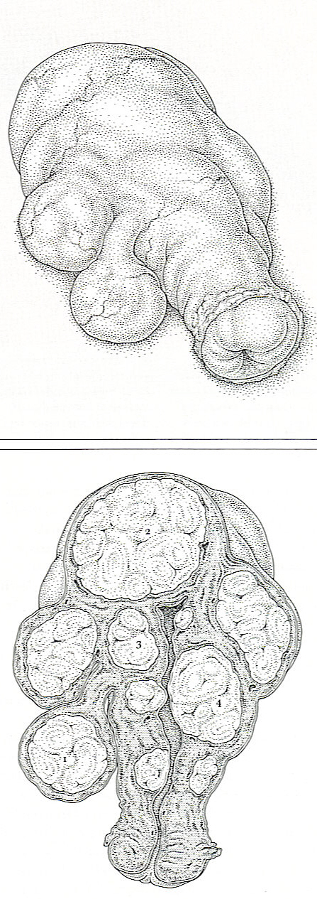
Subserous myoma
40% in women 40-50 years
Pedunculated myoma
Subserous myoma
Intramural myoma
Submucous myoma
Polyfibromatic uterus

Slide 8
Uterine Sarcomas: Histologic Subtypes
Leiomyosarcoma 5-year OS 50 to 0%; relapse rate 50% to 75% Prognostic factors: tumor size and grade
STUMP (smooth muscle tumors of unknown malignant potential)
Endometrial stromal sarcoma 5-year OS 98 to 55%; Prognostic factors: size, stage, no undifferentiated component
Rare: undifferentiated sarcoma (high grade), adenosarcoma (low grade)
Very rare: angiosarcoma, hemangiopericytoma, pleomorphic, liposarcoma, desmoplastic, GIST …

Slide 9
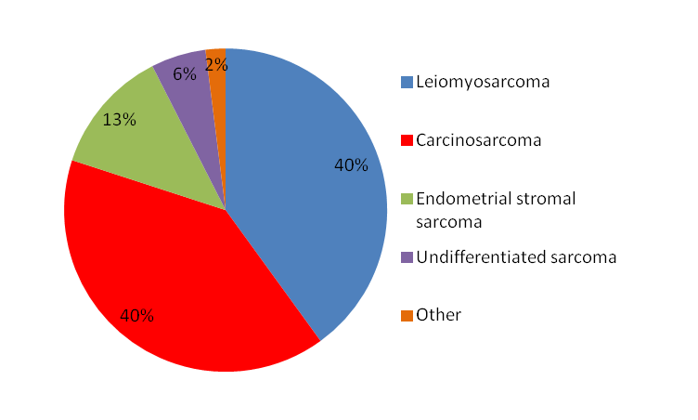
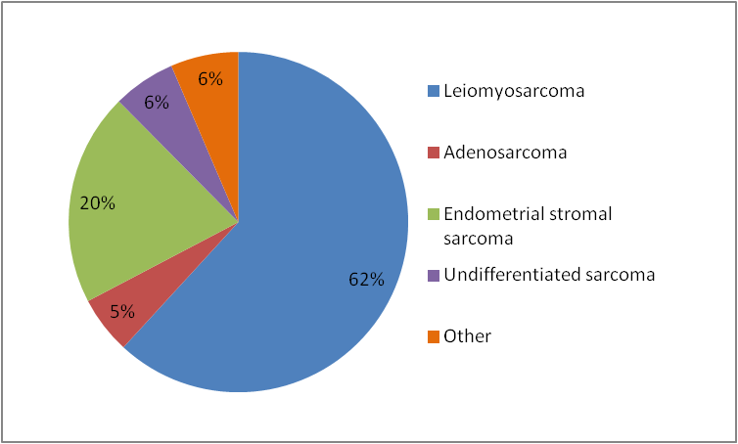
Uterine Sarcomas: Subtypes
Including Carcinosarcoma
Excluding Carcinosarcoma
Notes:
Prognosis is somewhat dependent on subtypes and grade, but better prognostic markers are needed!
LMS is by far the most common subtype
Statistics from abeler

Slide 10
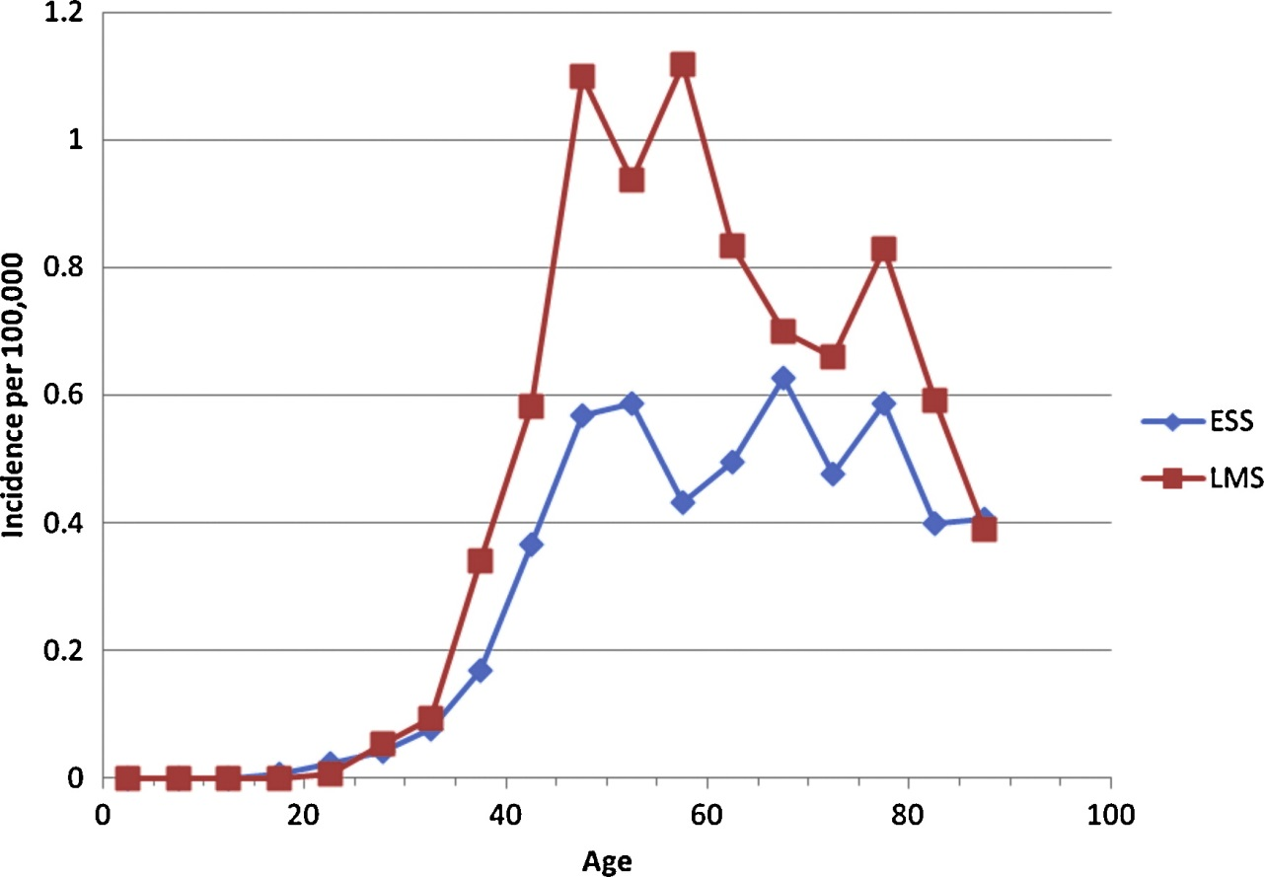
Incidence of LMS and Endometiral Stromal Sarcoma (ESS) Results from NORDCAN and NOCCA databases
LMS:0.4/100.000, ESS 0.3/100.000 (1978-2007)
Age-specific incidence rates:
Koivisto-Korander R, et al. Maturitas. 2012;72(1):56-60.
Notes:
Here, we analyzed trends in incidence and occupational variation
in risk of uterine leiomyosarcomas (LMS) and endometrial stromal sarcomas (ESS) in the Nordic countries
aided by NORDCAN and NOCCA (Nordic Occupational Cancer) databases.
Main outcome measures: Incidence rates per 100,000 and Standardized incidences rates (SIR) obtained
from NORDCAN and NOCCA databases.
Results: The incidence rates were about 0.3 per 100,000 for ESS and about 0.4 per 100,000 for LMS in
Denmark, Finland, Iceland, and Norway. During the study-period (1978–2007), the incidence rates in
each country were quite similar and constant. The age-specific incidence of LMS showed a peak around
menopause. Significantly increased risk for LMS occurred in shoe and leather workers, farmers and teachers,
whereas significantly low risk was detected with packers in the NOCCA data from Finland, Norway,
and Sweden. For ESS no occupations showed either increased or decreased incidences.
Conclusions: The incidence trends of LMS and ESS in our study were constant in four Nordic countries over
time. The elevated risk for LMS with women exposed to leather work and animal dust indicates further
exploration.

Slide 11

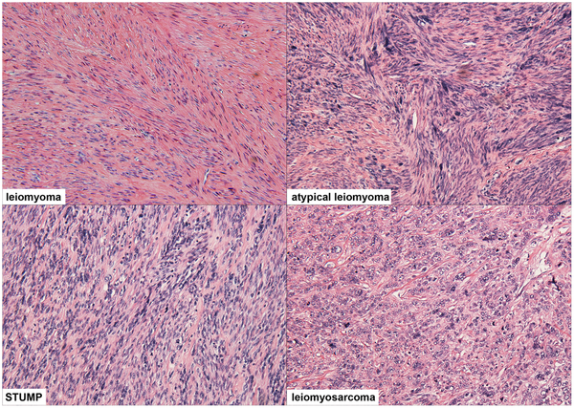
Smooth Muscle Cell Tumor Pathology Can Be Challenging
Seidman MA, et al. PLOS One. 2012;7(11):e5005.

Slide 12
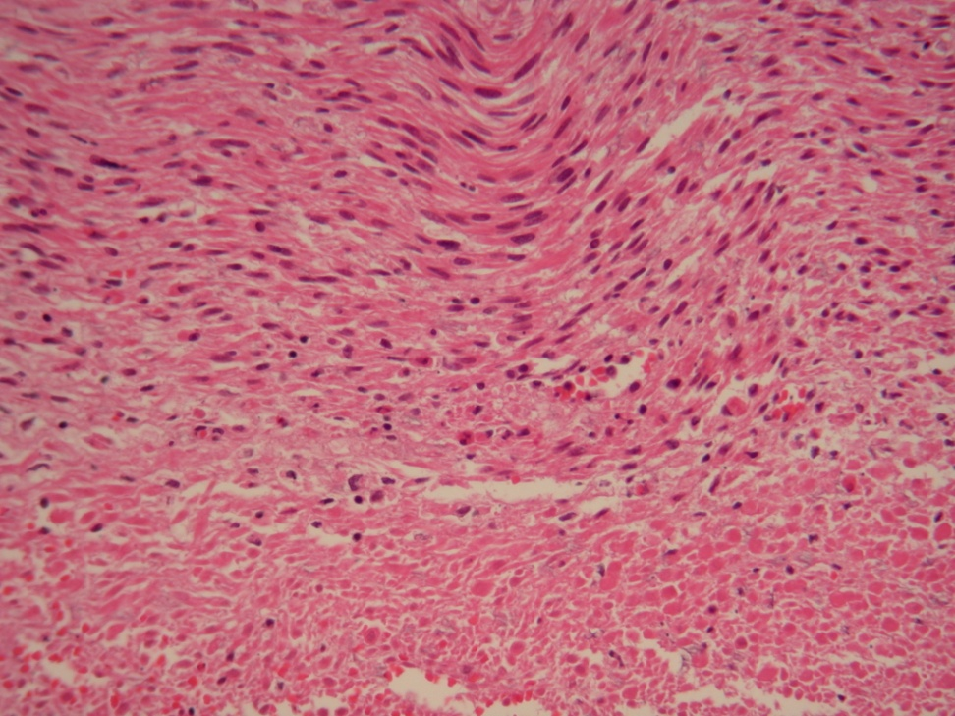
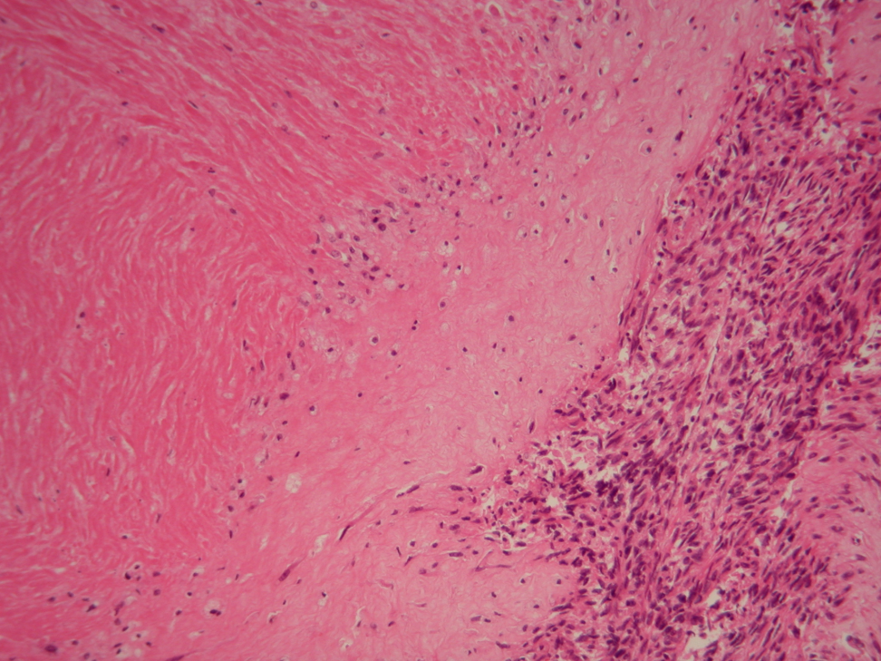
Pathology of Uterine LMS: Expert Opinion Might Be Necessary
Coagulative Tumor Cell Necrosis
Hyalyne Necrosis
Abrupt transition of living cells to necrotic cells without layer of granulation or fibrous tissue

Slide 13
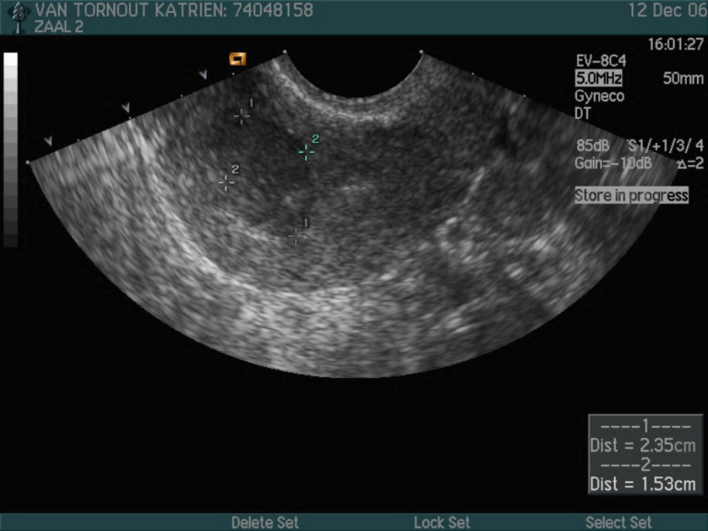
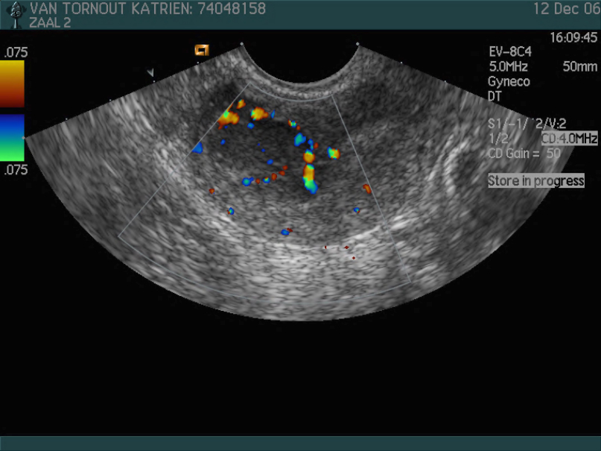
No Pathognomonic Features Predicting ESS
Transvaginal sonography, what can help….
 | ESS
Form | Mass derived from endometrium with irregular lining
Echogenicity | Hypoechogenic
Central necrosis | No
Doppler | Irregular central or circular

Slide 14
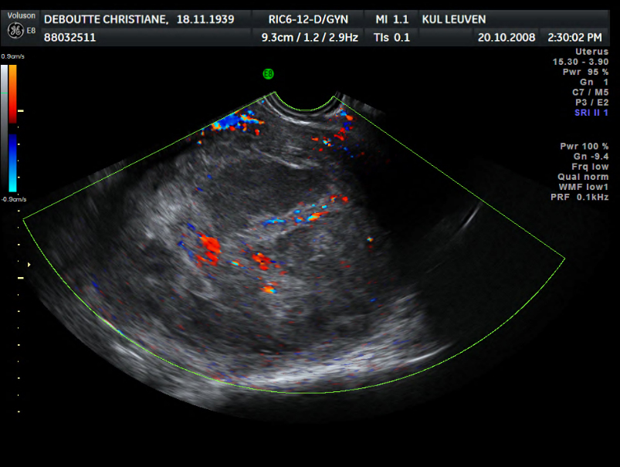
No Pathognomonic Features Predicting LMS
Transvaginal sonography, what may help….
 | Myoma | LMS
Shape | Round | Oval
Echogenicity | Frequent calcifications | Inhomogeous
Central necrosis | Rare | Yes
Doppler | Circular flow | Irregular distribution blood vessels, low resistance, high velocity

Slide 15
Agenda
Hot issue
Pathology and diagnosis of uterine smooth muscle cell tumors
Morcellation of leiomyomas
Morcellation of sarcomas
Risks of morcellation
Prevention of sarcoma morcellation
Treatment after sarcoma morcellation
Take-home message

Slide 16
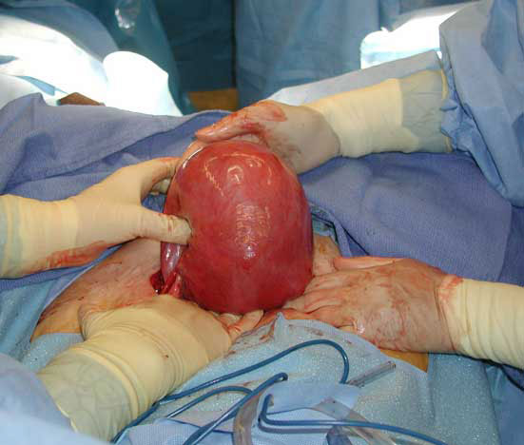

Slide 17
Treatment of Leiomyoma
Medication
GnRH analogues
Ulipristal acetate
Embolisation
Surgical
Hysteroscopy (diagnostic/therapeutic)
Laparoscopy
Myomectomy
Hysterectomy
Robot-assisted
Morcellation
Laparotomy
Notes:
Esmya is a medicine that contains the active substance ulipristal acetate. It is available as tablets (5 mg).
Esmya is taken by mouth and the recommended dose is one tablet a day for up to three months. The three-month treatment can be repeated but only once. Treatment should always be started during the first week of the menstrual cycle (period bleeding).
The active substance in Esmya, ulipristal acetate, is a ‘selective progesterone receptor modulator’. It acts by blocking the receptor of a hormone in the body called progesterone, which is involved in controlling the growth of the lining of the womb. In some women, progesterone may promote the growth of fibroids, which may cause symptoms such as heavy uterine bleeding (bleeding from the womb during or outside the menstrual period), anaemia (low red blood cell counts, due to bleeding) and abdominal pain (such as period pain or pain in the belly area). When progesterone activity is blocked, fibroid cells stop dividing and eventually die, which reduces the size of the fibroids and reduces the symptoms caused by them.

Slide 18
Growth of Leiomyoma During Gonadotropin: Level of Suspicion ↑
Meyer, Obstet Gynecol 1990
Loong and Wong, Fertil Steril 1990
Hitti, Fertil Steril 1991
Murphy, Gynecol Oncol 1993
Lee, Gynecol Oncol 1994
Milman D, Eur J Obstet Gynecol Reprod Biol 1998
Mesia, Obstet Gynecol 1998

Slide 19
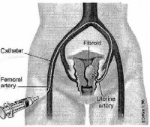
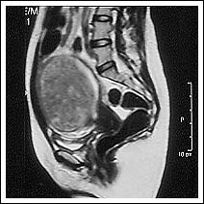
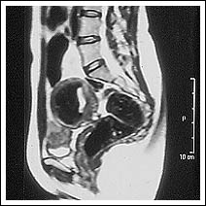
MRI before embolisation
Myoma
MRI after embolisation

Slide 20
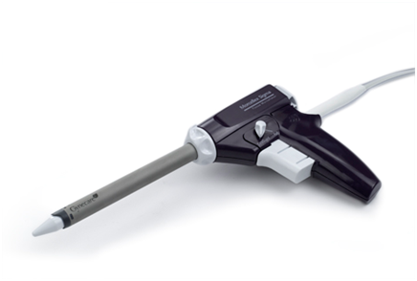
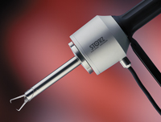
Morcellation: Historical Perspective
1973: hand-activated morcellator
1993: Steiner electromechanical morcellator
Current: Rotocut G1 morcellator (Karl Storz) & Gynecare Morcellex (Ethicon)

Slide 21
Agenda
Hot issue
Pathology and diagnosis of uterine smooth muscle cell tumors
Morcellation of leiomyomas
Morcellation of sarcomas
Risks of morcellation
Prevention of sarcoma morcellation
Treatment after sarcoma morcellation
Take-home message

Slide 22
Risks of Morcellation
Surgical
Spread of benign disease
Spread of malignant disease

Slide 23
Summary of Cases of Uterine Power Morcellation With Follow-Up Exploratory Laparotomy
Unexpected diagnoses in 1.2% of 1091 uterine morcellation cases (0.09% unexpected LMS)
Pathology:
1 stromal sarcoma (ESS)
1 cellular leiomyoma (CL)
6 atypical leiomyomas (AL)
3 smooth muscle tumor of uncertain malignant potential (STUMPs)
1 leiomyosarcoma (LMS)
Disseminated disease occurred in 64.3% of all (in house and consultation) tumors
0/1 ESS
1/1 CL
0/1 AL
4/4 STUMPs
4/7 LMS
Only disseminated leiomyosarcoma, however, was associated with mortality
Seidman MA, et al. PLOS One. 2012;7(11):e5005.

Slide 24
Intraoperative Images of Nodules on the Peritoneal Surface
Seidman MA, et al. PLOS One. 2012;7(11):e5005.

Slide 25
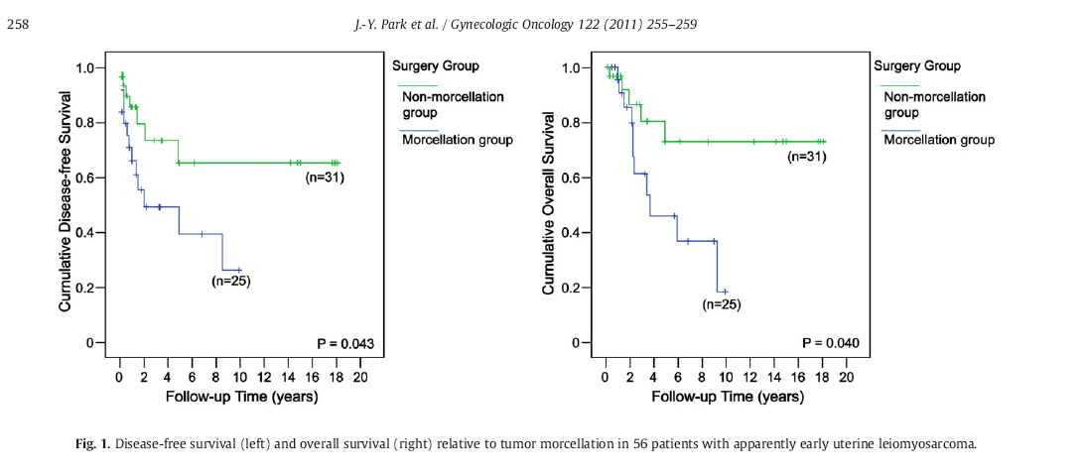
DFS and OS Relative to Tumor Morcellation in LMS (n = 56)
Park J-Y, et al. Gynecol Oncol. 2011;122(2):255-259.

Slide 26
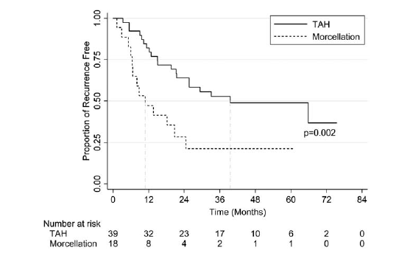
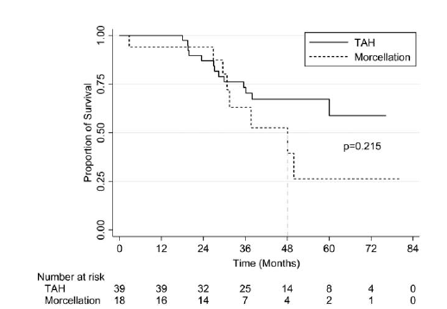
Retrospective Cohort Study Evaluating the Impact of Intraperitoneal Morcellation on Outcomes of Localized Uterine Leiomyosarcoma
George S, et al. Cancer. 2014;120(20):3154-3158.

Slide 27
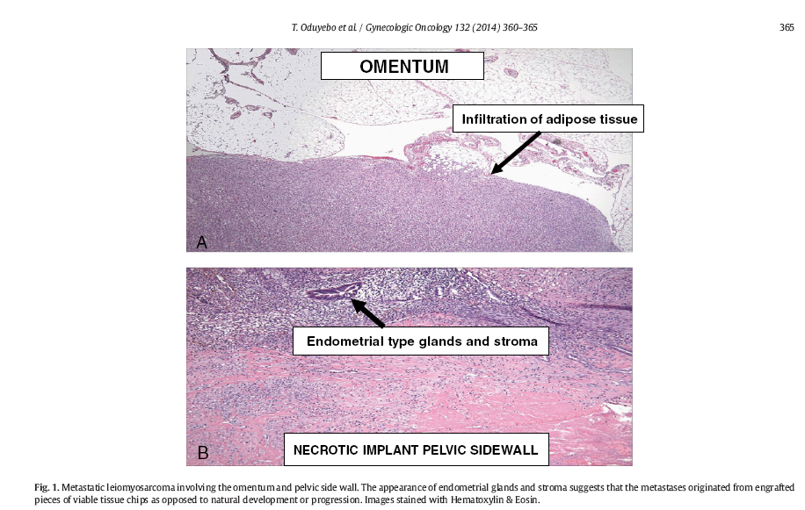
Metastatic Leiomyosarcoma Involving the Omentum and Pelvic Side Wall
Oduyedbo T, et al. Gynecol Oncol. 2014;132(2):360-365.
Notes:
The appearance of endometrial glands and stroma suggests that the metastases originated from engrafted pieces of viable tissue chips as opposed to natural development or progression.

Slide 28
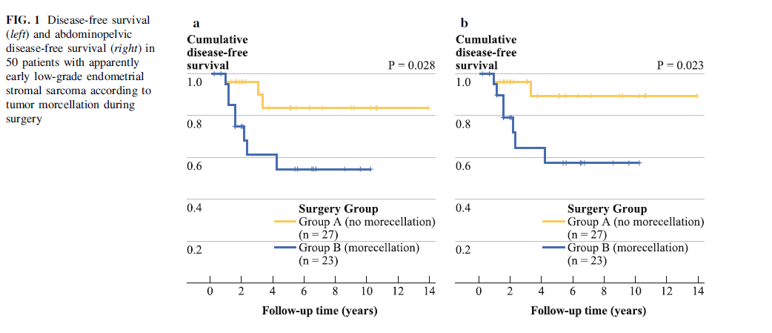
Follow-Up in 50 Patients With ESS According to Morcellation
Park J-Y, et al. Ann Surg Oncol. 2011;18(12):3453-3461.

Slide 29
Follow-Up in 50 Patients With ESS According to Morcellation
Lower DFS and abdominopelvic DFS rates
OS was not significantly compromised, due to:
adjuvant secondary surgery followed by chemotherapy or concurrent chemoradiation therapy
Indolent tumour behaviour of ESS
Park J-Y, et al. Ann Surg Oncol. 2011;18(12):3453-3461.

Slide 30
Strategy After Sarcoma Morcellation: Anecdotal Data Only!
Staging laparoscopy: merely prognostic
Adjuvant treatment:
ESS (? Idem for adenosarcoma, STUMP?)
Castration in premenopausal women
Progestins in all ages
LMS
No benefit of adjuvant chemo and/or radiotherapy

Slide 31
Barbara Goff, President of SGO
In the vast majority of cases, hysterectomy is done because of the presence of benign uterine fibroids. In these circumstances, intracorporeal morcellation has benefited hundreds of thousands of women. It is especially beneficial for obese women.
It would be a disservice to deny these women this option.
Goff B, et al. Lancet Oncol. 2041;15(4):e148.

Slide 32
April 2014: FDA News Release
The FDA concludes that the risk of morcellating an unsuspected uterine sarcoma is 1 in 352 and the risk of morcellating an unsuspected uterine leiomyosarcoma is 1 in 498.
The agency recommends that laparoscopic power morcellators no longer be used for hysterectomy or myomectomy in most women with uterine fibroids.
Notes:
FDA NEWS RELEASE
For Immediate Release: April 17, 2014 Media Inquiries: Jennifer Rodriguez, 301-796-8232, jennifer.rodriguez@fda.hhs.gov Consumer Inquiries: 888-INFO-FDA, dice@fda.hhs.gov
FDA discourages use of laparoscopic power morcellation for removal of uterus or uterine fibroids Procedure poses risk of spreading undetected cancerous tissue in women with unsuspected cancer
In a safety communication notice issued today, the U.S. Food and Drug Administration discouraged the use of laparoscopic power morcellation for the removal of the uterus (hysterectomy) or uterine fibroids (myomectomy) in women because, based on an analysis of currently available data, it poses a risk of spreading unsuspected cancerous tissue, notably uterine sarcomas, beyond the uterus.
Laparoscopic power morcellation is one of several available treatments for fibroids. It is a procedure that uses a medical device to divide the uterine tissue into smaller pieces or fragments so it can be removed through a small incision in the abdomen, such as during laparoscopy.
Uterine fibroids are non-cancerous growths that originate from the smooth muscle tissue in the wall of the uterus. According to the National Institutes of Health, most women will develop uterine fibroids at some point in their lives. While most uterine fibroids do not cause problems, they can cause symptoms, such as heavy or prolonged menstrual bleeding, pelvic pressure or pain, and frequent urination, sometimes requiring medical or surgical therapy.
Based on an analysis of currently available data, the FDA has determined that approximately 1 in 350 women who are undergoing hysterectomy or myomectomy for fibroids have an unsuspected type of uterine cancer called uterine sarcoma. If laparoscopic power morcellation is performed in these women, there is a risk that the procedure will spread the cancerous tissue within the abdomen and pelvis, significantly worsening the patient’s likelihood of long-term survival.
“The FDA’s primary concern as we consider the continued use of these devices is the safety and well-being of patients,” said William Maisel, M.D., M.P.H., deputy director for science and chief scientist at the FDA’s Center for Devices and Radiological Health. “There is no reliable way to determine if a uterine fibroid is cancerous prior to removal. Patients should know that the FDA is discouraging the use of laparoscopic power morcellation for hysterectomy or myomectomy, and they should discuss the risks and benefits of the available treatment options with their health care professionals.”
A number of additional treatment options are available for women with symptomatic uterine fibroids, including traditional surgical hysterectomy (performed either vaginally or abdominally) and myomectomy, and laparoscopic hysterectomy and myomectomy without morcellation, as well as other non-surgical options.
The FDA will convene a public meeting of the Obstetrics and Gynecological Medical Devices Panel to discuss information related to laparoscopic power morcellation.
“Input from clinical and scientific experts will help provide valuable information and perspectives to clarify the proper clinical role for these devices,” said Maisel. “We anticipate the discussion will include whether a boxed warning related to the risk of cancer spread should be added to the product labeling for laparoscopic power morcellators to ensure patients and health care professionals are adequately informed of the risks.”
In the interim, the agency has instructed manufacturers of power morcellators used during laparoscopic hysterectomy and myomectomy to review their current product labeling for accurate risk information for patients and health care professionals.
Based on currently available information, the FDA’s recommendations for health care professionals include:
Be aware that the FDA discourages the use of laparoscopic power morcellation during hysterectomy or myomectomy for the treatment of women with uterine fibroids.
Do not use laparoscopic uterine power morcellation in women with suspected or known uterine cancer.
Carefully consider all the available treatment options for women with symptomatic uterine fibroids.
Discuss the benefits and risks of all treatments with patients.
After carefully weighing the risks and benefits of the procedure, if a health care professional nonetheless determines that laparoscopic power morcellation is the best therapeutic option for his or her patient, the health care professional should:
Inform patients that their fibroid(s) may contain unexpected cancerous tissue and that laparoscopic power morcellation may spread the cancer, significantly worsening their prognosis.
Be aware that some clinicians and medical institutions now advocate using a specimen “bag” during morcellation in an attempt to contain the uterine tissue and minimize the risk of cancer spread in the abdomen and pelvis.
FDA’s recommendations for women include:
Discuss all the options available to treat your condition, including the risks and benefits of each with your health care professional.
If laparoscopic hysterectomy or myomectomy is recommended, ask your health care professional if power morcellation will be performed during your procedure and why it is the best treatment option for you.
If you have already undergone a hysterectomy or myomectomy for fibroids, tissue removed during the procedure is typically tested for the presence of cancer. If you were informed these tests were normal and you have no symptoms, routine follow-up with your physician is recommended. Patients with persistent or recurrent symptoms or questions should consult their health care professional.

Slide 33
Patient Triage UZ Leuven Recommendations on Morcellation
Discourage
Oval, solitary lesions
Central necrosis
Fast growth (3 months)
Irregular lining
High blood flow
Atypical growth
Postmenopausal
Post embolisation
GnRH analogues
Ovarian fibroma
In favor
Round lesion
Many small lesions
Regular lining
Low blood flow
Calcifications

Slide 34
Morcellation in Laparoscopic Bag?
Not for myomectomy
No extensive, prospective, and reliable research data (Tanos et al. Gynecologic Surgery, in press, 2015)
In-bag ‘contained morcellation’ (Wu SD, et al. J Endourol. 2009;23(9):1513-1518.)
Safe in 188 patients with low-grade renal cell cancer (follow-up only 21 months)
1 port-site metastasis

Slide 35
Agenda
Hot issue
Pathology and diagnosis of uterine smooth muscle cell tumors
Morcellation of leiomyomas
Morcellation of sarcomas
Risks of morcellation
Prevention of sarcoma morcellation
Treatment after sarcoma morcellation
Take-home message

Slide 36
Take-Home Message
Morcellation of uterine leiomyomas poses risk of spreading undetected cancerous tissue in women with unsuspected cancer
Risk reduction strategies:
Abandon morcellation
Patient triage
Morcellation in laparoscopic bag?
Informed consent
3-4 higher chance recurrence
2.5 fold chance to die of disease

